Slide 1
Customer Life Time Value (CLTV) Predictions
Auto Insurance Company

Slide 2
Overview
Objective
Company's Approach and Insight
We are expected to create an analytical and modelling framework to predict the lifetime value of each customer based on the quantitative and qualitative features. On the basis of CLV we will predict whether or on what variable we need to acquire a new customer or retain the current customer.
A major non-life insurance company wants to evaluate customer lifetime value based on each customer’s demographics and policy information including claim details.
The CLTV is a profitability metric in terms of a value placed by the company on each customer and can help to predict the customer value in terms of profit and also helps to determine the kind of customer needs to be acquire on future comparing with the current valuable/profitable customers variable.

Slide 3
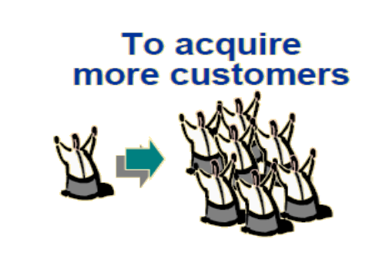
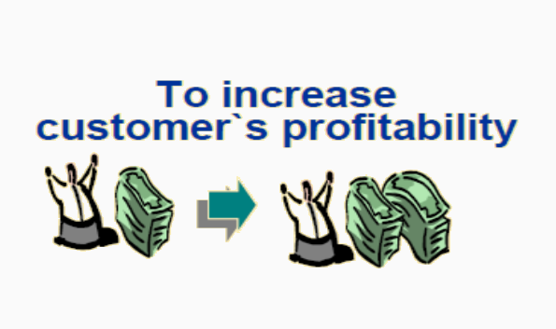
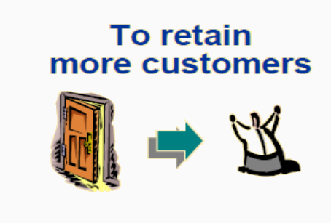
Business Strategies

Slide 4
CLV Helps to answer……
More Efficient Customer Retention
Do the Customer have high potential?
PROFIT
Do the new customer has same profile as valuable customer?
Recovery of Potential Valuable Customers
Do the Customer have low potential?
PROFIT
More Efficient acquisition of new customers
Faster Termination of Less Valuable Customer
TIME
Acquisition
Retention
Termination

Slide 5


Demo graphs of the Final Data Frame
Initial Data Frame with 9134 rows and 24 variables
Feature engineered Data Frame With
8378 rows by 10 feature variables
Transformation
Customer Centric | Business Centric | Customer Demo graphs
Income | Sales Channel | Education
Employment status | Monthly Premium Value | Marital Status
No. of Policies | Policy & Offers | Location
Vehicle Class | Coverage | Gender
Hopmonk Dataset Summary:
Total Observations : 8378
Total variables : 10
Target Variable : Customer Life Time Value
Module : Linear Regression
Evaluation Metric : R2

Slide 6
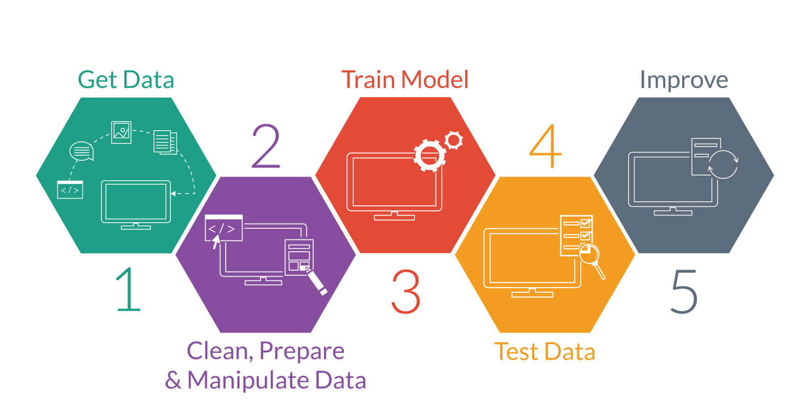
Model Building
Get Data
Prepare Module
Improve
Clean Data
Manipulate Data

Slide 7
Data Insights

Slide 8
Conclusion and Recommendations
As the Customer who is using Four Door Car and SUV car are more inclined to coverages and even the Loss(Total claim amount) incurred by them is more.
After Clustering we can easily find that the Employed married customer with Four Door and Tow Door car is maximum in number(almost 70%) and even the income and CLTV is also high so we can easily say that those are the valuable customers and required to be retain and target to acquire those type of customers in future by giving offers, as they will provide more profit as compare to other customer.
Group of Unemployed customer is not a profitable customer for the company as the contribution of CLTV is 24% but the Total claim amount in 35% which is huge in number and we need to terminate those customer and try to avoid unemployed customer is future.
38% of the Suburban customer has taken more than 1 policy which signify that the suburban customer are more likely to take more no. of policies as compare to other location customer, so we should provide offers on taking more no. of policies in rural and urban location in order to improve the percentage of policy taken.
Concluding that Linear Regression Model is stable in order to predict the CLTV.

Slide 9
THANK You

